Slide 1
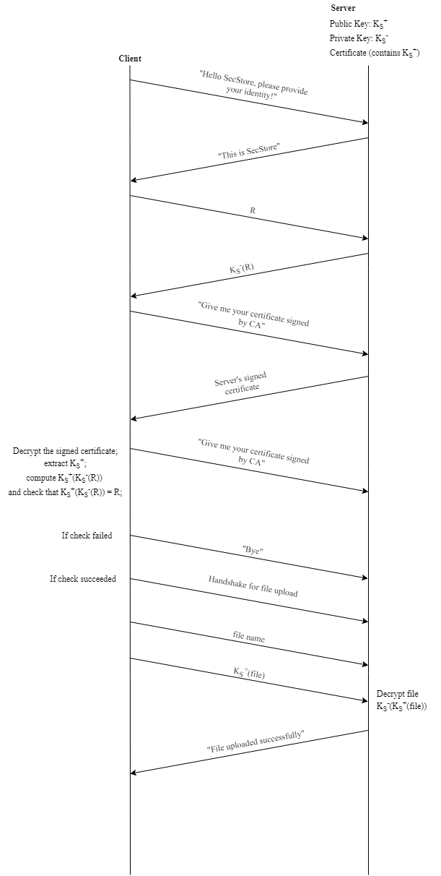
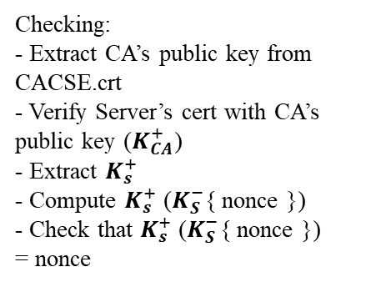

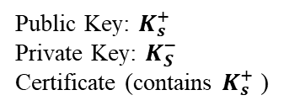
AP
Server
Client
Public Key: $K_{s}^{+}$
Private Key: $K_{S}^{−}$
Certificate (contains $K_{s}^{+}$ )
Client generated nonce
R = $K_{S}^{−}${ nonce }
“Give me your certificate signed by CA”
Checking:
- Extract CA’s public key from CACSE.crt
- Verify Server’s cert with CA’s public key ($K_{CA}^{+}$)
- Extract $K_{s}^{+}$
- Compute $K_{s}^{+}$ ($K_{S}^{−}${ nonce })
- Check that $K_{s}^{+}$ ($K_{S}^{−}${ nonce })
= nonce
Server’s signed certificate
If check failed
“Bye”
If check succeeded
Handshake for file upload

Slide 2



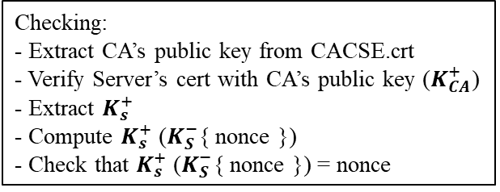



CP-1
Server
Client
Public Key: $K_{s}^{+}$
Private Key: $K_{S}^{−}$
Certificate (contains $K_{s}^{+}$ )
Client generated nonce
R = $K_{S}^{−}${ nonce }
“Give me your certificate signed by CA”
Checking:
- Extract CA’s public key from CACSE.crt
- Verify Server’s cert with CA’s public key ($K_{CA}^{+}$)
- Extract $K_{s}^{+}$
- Compute $K_{s}^{+}$ ($K_{S}^{−}${ nonce })
- Check that $K_{s}^{+}$ ($K_{S}^{−}${ nonce }) = nonce
Server’s signed certificate
If check failed
“Bye”
If check succeeded
Handshake for file upload
- Encrypt file name & file size
$K_{s}^{+}$(file name), $K_{s}^{+}$(file size)
- Decrypt file name ($K_{S}^{−}$(file name))
- - Decrypt file size ($K_{S}^{−}$(file size))
- Encrypt file block ($K_{S}^{+}$(file block))
$K_{s}^{+}$(file block 1)
.
.
.
- Decrypt file block ($K_{S}^{−}$(file block))
$K_{s}^{+}$(file block n)
Close connection

Slide 3
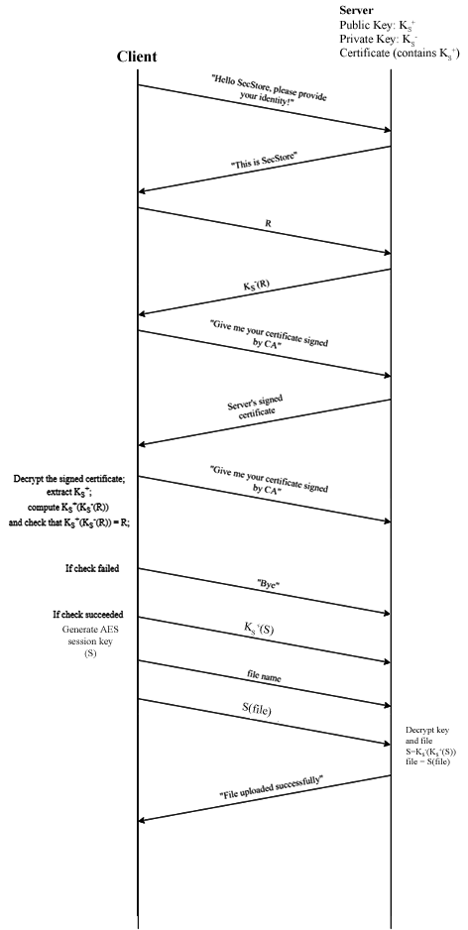
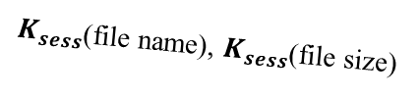






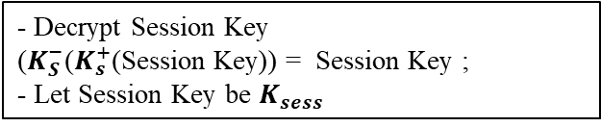
CP-1
Server
Client
Public Key: $K_{s}^{+}$
Private Key: $K_{S}^{−}$
Certificate (contains $K_{s}^{+}$ )
Client generated nonce
R = $K_{S}^{−}${ nonce }
“Give me your certificate signed by CA”
Checking:
- Extract CA’s public key from CACSE.crt
- Verify Server’s cert with CA’s public key ($K_{CA}^{+}$)
- Extract $K_{s}^{+}$
- Compute $K_{s}^{+}$ ($K_{S}^{−}${ nonce })
- Check that $K_{s}^{+}$ ($K_{S}^{−}${ nonce }) = nonce
Server’s signed certificate
If check failed
“Bye”
If check succeeded
$K_{s}^{+}$ (Session Key)
- Decrypt Session Key ($K_{S}^{−}$($K_{s}^{+}$(Session Key)) = Session Key ;
- Let Session Key be $K_{sess}$
- Encrypt file name & file size
$K_{sess}$(file name), $K_{sess}$(file size)
- Decrypt file name ($K_{sess}$(file name))
- Decrypt file size ($K_{sess}$(file size))
- Encrypt file blocks ($K_{sess}$(file block))
$K_{sess}$(file block 1)
.
.
.
- Decrypt file blocks ($K_{sess}$(file block))
$K_{sess}$(file block n)
Close connection

